Slide 1
“How To Create The Perfect “Business Presentation” Without Having To Sound Like A Robot Who’s Joined A Cult”

Slide 2
“How to Build a “Network Marketing Business” online WithOUT having to ever host a Product Party or Meet Someone for Coffee EVER Again.

Slide 3
If You Stay Until The End…

Slide 4
My Goal…

Slide 5
What Makes This Different?

Slide 6
Dan & Liz
The KING & QUEEN of Network Marketing Online
20 years in Direct Sales and Network Marketing between us
Created 3 businesses form scratch to 6 figure income using Social Media
Earned Mercedes Benz with Arbonne International in 16 months
Grew business in MLM from $3000 to $54,000 in less than 180 days completely online

Slide 7
Done A Lot Of Things WRONG…

Slide 8
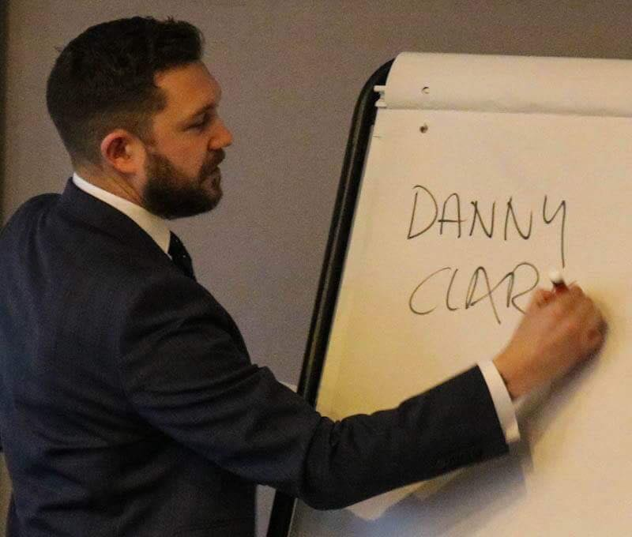
After Doing This For 8+ Years…
I Have Got Really Good On Social Media And How To Use Effectively To Market Myself And Grow My Personal Brand
I Have Learned How To Become More Influential Online As An Authority Figure
How To Connect With Prospects And Turn Them In To Raving Fans
How To Create Effective Curiosity In Your Business
How To Apply Logical Thinking So Your Prospects Understand The How
How To Follow Up Effectively
How To Use Facebook Groups To Sell MLM Products Without The Need For Parties And One To Ones
No More Feeling Like An Annoying Spammy Dick

Slide 9
I Discovered This The HARD Way (You Get To Cheat And Get The Easy Way)

Slide 10
The Hard Way…
I Called People… (HATED It)
Travelled 2 Hours To Meet Someone For Coffee And They Didn’t Turn Up
Being Called A Scam Artist At a Product Party
Being Ignored By Friends And Family For Being That Annoying MLM Person

Slide 11
Want The Easy Way That Does NOT Require YOU To EVER Host A Party Or Meet Someone For Coffee Again… ?

Slide 12
In Our First 60 Days We Have 67 People Who Have Joined The VIP Life… (Using The Exact Same Principles We Teach Here…)

Slide 13
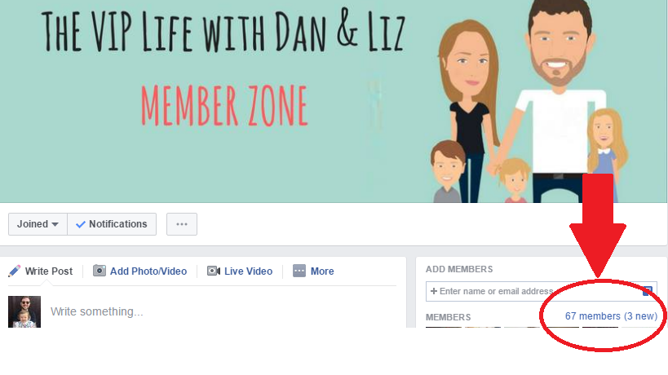

Slide 14
RESULTS ARE NOT TYPICAL… I will walk you through specific promotions and systems that are earning huge recruitment growths right now. My results are certainly not typical & the average person who attends any trainings gets zero results. HOWEVER, I’m happy to show you exactly what is working for me – FREE. This is NOT for “get rich quick” people or amateurs.

Slide 15
The 3 Secrets… Secret #1 – I Can Speak To More People In One Day To Join My MLM Opportunity Then I Can In A Month The Traditional Way… Secret #2 – You Don’t Have To Buy Loads of Products For Parties So Your Clients Have Chance To Try It All Secret #3 – I Only Need A LITTLE Engagement On My Social Media To MAKE This Work (About 100-150 Likes And Comments Per Month)

Slide 16
Secret #1 – I Can Speak To More People In One Day To Join My MLM Opportunity Then I Can In A Month The Traditional Way…

Slide 17
MLM Secrets: Secret #1
2 Hour Coffee Date…
Prospecting Time 2 Hours A Day…
30 One To Ones A Month
120 Hours A Month
27 Hours A Week On Top Of Day Job

Slide 18
MLM Secrets: Secret #1
One Hour A Day Required To Build Your Business On Social Media
Digital Footprint Compound Effect
Simple Duplication
No Need To Learn Presentation or Products
You Are Branding You To Stand Out From The Crowd

Slide 19
Secret #2 – You Don’t Have To Buy Loads of Products For Parties So Your Clients Have Chance To Try It All

Slide 20
MLM Secrets: Secret #2
3 Reason’s Why Most People (Like Me) Shouldn’t EVER build a MLM business traditionally
Too Busy
Too Scared
Lack Of Knowledge

Slide 21
MLM Secrets: Secret #2
Can Build Your Business Anywhere In The World
Less $$$ Spend Required To Build Business Equals Greater Profit Margin For You
Can Build Your Business With True Leverage And Scalability

Slide 22
Secret #3 – I Only Need A LITTLE Engagement On My Social Media To MAKE This Work (About 100-150 Likes And Comments Per Month)

Slide 23
MLM Secrets: Secret #3
I Don’t Know Enough People
I Don’t Think People Can Afford My Products
I Don’t Want To Spam My Social Media Newsfeed With Products And Annoy My Friends And Family

Slide 24
MLM Secrets: Secret #3
You Can Network With New People Every Single Day Without Ever Leaving Your Home
You Can Connect with Your Perfect Target Market
Grow Your Business Online Without Ever Mentioning Your Companies Name Publicly

Slide 25
The Experiment…
Old Model
Make A 100 Person List And Contact Every Person You Know
The 3 Foot Rule (Talk To Everyone You Know Who Is Within Touching Distance)
New Model
Have People Contact You On A Daily Basis Wanting To Know About Your Opportunity…
Work With People Who Want To Build Online In The Same Way Equals Quicker Growth
Build A Global Business With No Geographical Limitations

Slide 26
The Experiment…
LOTS Of Wasted Time…
Two Attempts Without Achieving Success…
Made A Financial Loss On Both Occassions…
Created Our 6 Step Blueprint
The Following Month $16,000 In Sales
Earned A Significant Profit In Only 180 Days
Out Promoted People Who Had Been In The Business Over 5 Years

Slide 27
The Experiment…
LOTS Of Wasted Time…
Two Attempts Without Achieving Success…
Made A Financial Loss On Both Occassions…
Created Our 6 Step Blueprint
The Following Month $16,000 In Sales
Earned A Significant Profit In Only 180 Days
Out Promoted People Who Had Been In The Business Over 5 Years

Slide 28
How Many Hours Do You Need?
Building a Traditional MLM Business
2 Hour Coffee Date…
Prospecting Time 2 Hours A Day…
30 One To Ones A Month
120 Hours A Month
27 Hours A Week On Top Of Day Job

Slide 29
How Many Hours Do You Need?
Building A Network Marketing Business Online
- One Hour A Day Without Having To Leave Your Home

Slide 30
What You’re Gonna Get…
#1 How To Find Prospects (£297 Value)
#2 How To Connect With Your Audience (£125 Value)
#3 How To Introduce The Business So You Prospects Say ‘Yes’ (£125 Value)
#4 How To Emotionally Connect With Your Prospects (£125 Value)
#5 How To Explain How This Business Works So Your Prospects Understand (£297 Value)
#6 How To Get Your Prospects To Join And Build Huge Organisations (£297 Value)
Total Value: £1266

Slide 31
Bonus #1
How To Use Social Media In 2017...
(£399 Value)
NOTE: This Bonus For First 30 People Only

Slide 32
Bonus #2
How To Use Use Facebook Groups To Launch Your Downline’s Business Online And To Sell Products Without Samples Or Trial Kits
(£399 Value)
NOTE: This Bonus For First 20 People Only

Slide 33
What You’re Gonna Get…
#1 How To Find Prospects (£297 Value)
#2 How To Connect With Your Audience (£125 Value)
#3 How To Introduce The Business So You Prospects Say ‘Yes’ (£125 Value)
#4 How To Emotionally Connect With Your Prospects (£125 Value)
#5 How To Explain How This Business Works So Your Prospects Understand (£297 Value)
#6 How To Get Your Prospects To Join And Build Huge Organisations (£297 Value)
#7 How To Use Social Media In 2017... (£399 Value)
#8 How To Use Use Facebook Groups To Launch Your Downline’s Business Online And To Sell Products Without Samples Or Trial Kits (£399 Value)
Total Value: £2064

Slide 34
Now YOU Have Two Choices…
First Option – Do Nothing And NOT Take This Leap Of Faith (Which is 100% Risk Free)
Second Option – Pay This Small Investment Today (Compared To All The Value You Will Get In Return And Just Give It A Shot!)

Slide 35
My CRAZY Guarantee…
Social Media Engagement (If You Can’t Get More Engagement On Your Social Media In 2 Weeks And Can Provide Evidence That You Have Implemented Our Strategies I Will Pay You A Refund Plus 100% Extra
Get Started Now: https://app.moonclerk.com/pay/k859esoi6bs

Slide 36
Password For Video Link Is

Slide 37
What You’re Gonna Get…
#1 How To Find Prospects (£297 Value)
#2 How To Connect With Your Audience (£125 Value)
#3 How To Introduce The Business So You Prospects Say ‘Yes’ (£125 Value)
#4 How To Emotionally Connect With Your Prospects (£125 Value)
#5 How To Explain How This Business Works So Your Prospects Understand (£297 Value)
#6 How To Get Your Prospects To Join And Build Huge Organisations (£297 Value)
#7 How To Use Social Media In 2017... (£399 Value)
#8 How To Use Use Facebook Groups To Launch Your Downline’s Business Online And To Sell Products Without Samples Or Trial Kits (£399 Value)
#9 15 Minute Turbo Call With Danny (£59 Value)
#10 Access To All Recordings From The Free Life
Total Value: £2123

Slide 38
Get Started NOW For Just £95 A Month Click The Button Below or SignUp Here: https://app.moonclerk.com/pay/k859esoi6bs

